Slide 1
Noise Robust Speaker Region Identification
Group 6
Yuxin Yin
Hanyu Zhang
Bingqing Hu
3/13/2024
Notes:
Good morning everyone! This is group 6 and I am Yuxin, this is Hanyu, and this is Bingqing.
The project we made is about the noise robust speaker region identification . The keys of our project consist of what features we extracted and what learning model we chose. There are many kinds of features we could extract for the audio speech and also various learning methods not only machine learning but also neural networks. In our team, we have implemented three entirely distinct pipelines. Moving forward, we will individually introduce each of these pipelines, and will showcase a performance comparison in the last part.

Slide 2
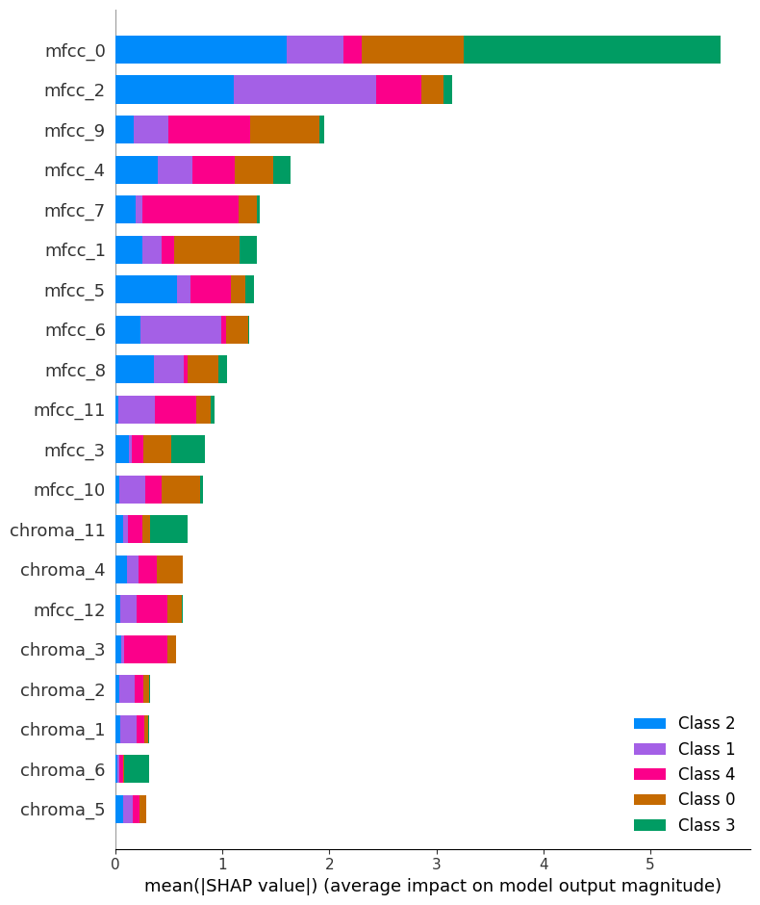
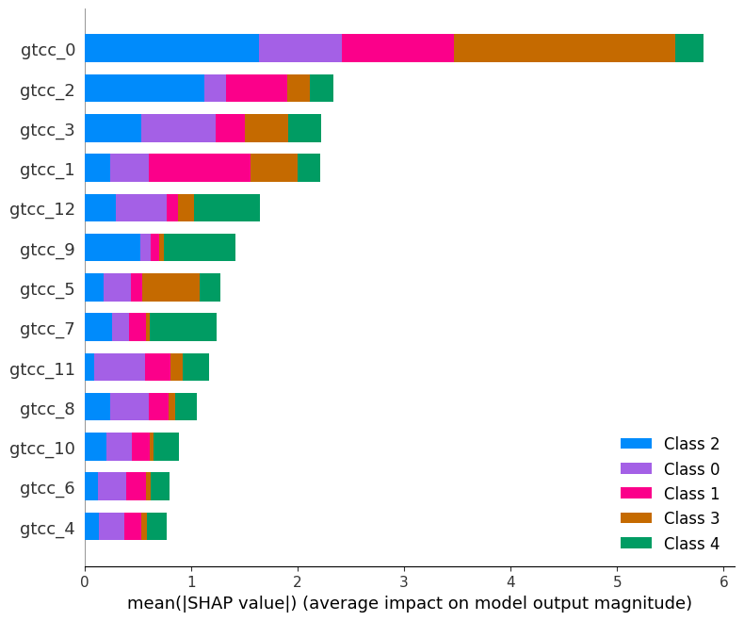
GTCC+MFCC with XGBoost
GTCC (Gammatone Frequency Cepstral Coefficients)
Characteristics:
Reflects human auditory system response.
Captures temporal and spectral aspects.
Relevance to dialect classification:
Robustness to background noise.
Efficient in capturing speech features in various dialects.
MFCC (Mel Frequency Cepstral Coefficients)
Characteristics:
Logarithmic mel-frequency scale.
Captures spectral features.
Relevance to dialect classification:
Widely used in speech recognition tasks.
Effective in capturing phonetic differences across dialects.
Chroma: Represents pitch class.
Captures intonation patterns specific to dialects.
Tempo: Speed or pace of music or speech.
Reflects rhythmic patterns unique to dialects.
Helps in distinguishing dialects based on speaking pace.
Notes:
Now, let’s delve into the details of the first pipeline.
The first pipeline used GTCC+MFCC features combined with XGBoost.
GTCC is the gammatone frequency cepstral coefficients, which can capture both temporal and spectral aspects.
MFCC is the Mel frequency cepstral coefficients, which mainly captures the spectral features.
and here we also used chroma and tempo, which represents the pitch class and pace of speech respectively.
Based on the provided baseline model, we can see mfcc performs well on clean datasets but struggles with noisy datasets.
Thats why I want to introduced gtcc here, the cubic root scale it used provides a better robustness to background noise, which is exactly what MFCC lacks.
So we divided into two feature extraction groups, the one is pure gtcc, the other is mfcc+chroma+tempo.
Here are their shap plots, the right one is from gtcc, the left is from mfcc.
As we can see obviously right here, not every feature we extracted are significant to our classification. for example, mfcc_0 accounts for a huge portion but it does not perform well on class 1 which is pink color.
Thats why I selected the features based on these two shap plots and created our first pipeline as shown here.

Slide 3
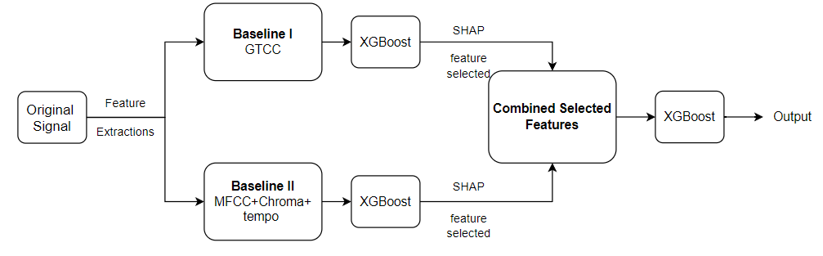
GTCC+MFCC with XGBoost
Pipeline
Overview:
Extract GTCC and MFCC+Chroma+tempo respectively as baseline I and baseline II
Get the XGBoost classification accuracy difference as follows
Baseline I: Higher noisy test acc
Baseline II: Higher clean test acc
Select the most important features based on the SHAP plots
Concatenate two feature training data with the corresponding selected features
Fine-tune the hyperparameters of XGBoost
Notes:
We extracted two groups features to the original audios separately and trained on XGBoost. Then we got the SHAP plots as show before, and selected the top significant features.
Then we concatenated two feature training data with the corresponding selected features.
At last, fine-tune the XGBoost and start training on it.
Here are the three test accuracy derived from the pipeline.

Slide 4
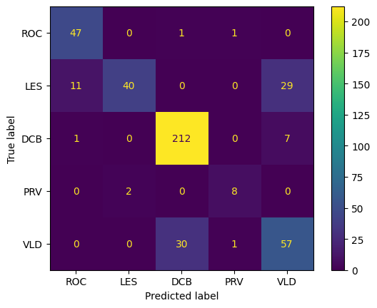
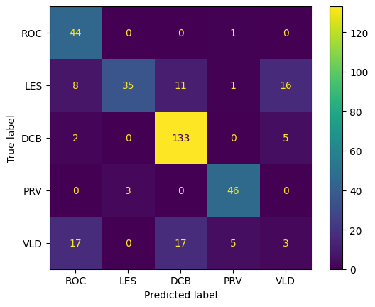
GTCC+MFCC with XGBoost
Clean
Test Data
Results
 | Training ACC | Clean Testset ACC | Noisy Testset ACC
Baseline I (GTCC) | 100% | 71.81% | 81.27%
Baseline II (MFCC+Chroma+tempo) | 100% | 82.10% | 53.03%
GTCC + MFCC with XGBoost | 100% | 81.43% | 75.22%
Noisy
Test Data
Still can select more on VLD class features from the given confusion matrix, and cross validate to balance the trade-offs between the noisy and clean test accuracy.
Notes:
We can see right here, the baseline one which is gtcc, performs very well on noist test data, reaching 81 percentage ish.
The baseline two, mfcc+chroma+tempo, shows strong performance on clean test data, reaching 82% ish.
However, both of them struggles in the opposite one.
The third one is the combination of two selected feature groups, it works well on the trade-off between clean and noisy. The clean reaches 81% and noisy one gets 75% ish.
On the right hand is the confuison matrix from the third model, we can see it performs well on both sides.
But further more, vld is not classified very well on noisy sets, prv is not very well on clean sest. Cross validation might be a good way for us to balance the trade-offs between these two.
This is basically what i made.

Slide 5
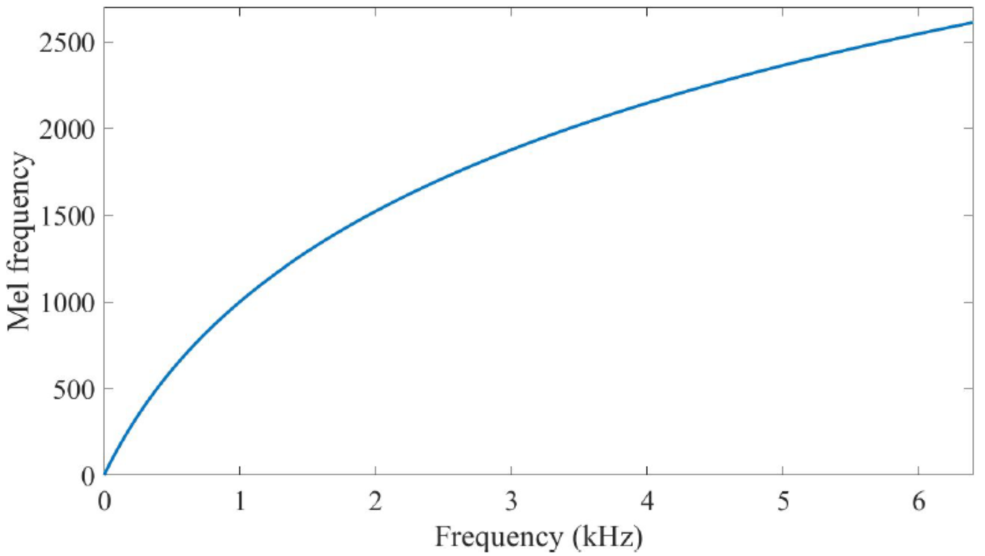
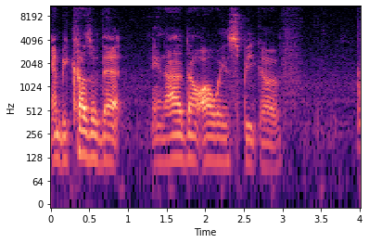
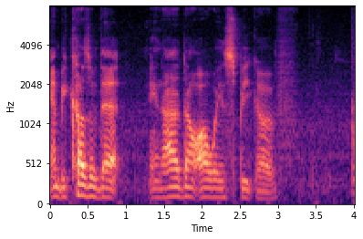
Mel Spectrogram & CNN
Mel scale: A scale of pitches judged by listeners to be equal in distance one from another. It allocates more frequency bins (higher resolution) to lower frequencies
Mel-spectrogram: STFT where y-axis is mel scale
Why Mel-spectrogram: better feature map
STFT
Mel-spectrogram

Slide 6
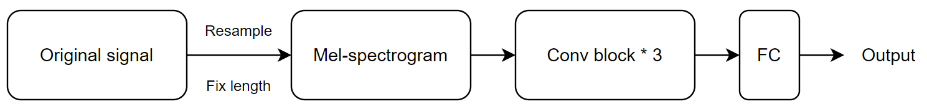
Mel Spectrogram & CNN
Pipeline
Details:
Resampling rate = 16000
Only select first 4 seconds signal (Ensure identical feature map size)
Conv block = 3*3 conv + BatchNorm + ReLU + 2*2 max pool
Training parameters: batchsize = 64, lr = 1e-4, loss function = CrossEntropy, epochs = 100, optimizer = Adam

Slide 7
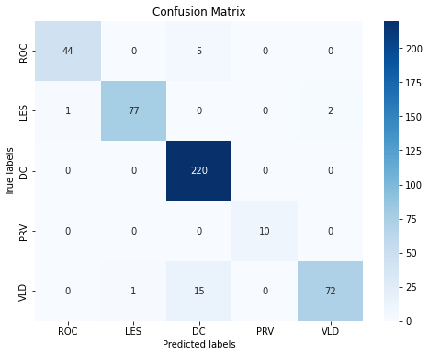
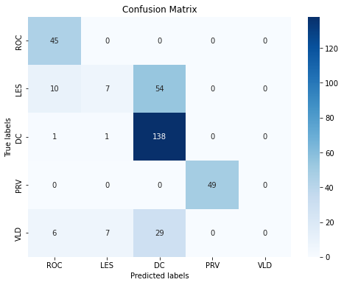
Mel Spectrogram & CNN
Results
Training Accuracy | Clean Testset Accuracy | Noisy Testset Accuracy
99.73% | 94.63% | 68.88%
Clean Testset
Noisy Testset
Why bad performance on noisy testset?
Unbalanced training data
No noise in training data

Slide 8
OpenSMILE & RandomForest
openSMILE：OpenSMILE is a robust audio processing tool for feature extraction, instrumental in speech and emotion recognition tasks.
eGeMAPS
ComParE 2016
Around 88 features
Targeted at characteristics related to emotion and physical state
A minimalistic set of acoustic parameters designed for voice research and affective computing.
May not capture enough variability to distinguish between different cities' speakers under noisy conditions.
6,373 features
Targets a broad spectrum of acoustic phenomena
A comprehensive feature set developed for the Interspeech 2016 Computational Paralinguistics Challenge, covering a wide range of spectral, prosodic, and voice quality characteristics.
Its extensive set of features may provide more robust performance against background noise and a higher likelihood of capturing discriminative characteristics in speech for different cities.
Notes:
So we also apply OpenSMILE, a powerful audio processing tool, combined with the RandomForest machine learning algorithm.
OpenSMILE simd at extracting features essential for recognizing speech and emotion.
I mainly focus oncompare two feature sets: eGeMAPS and ComParE 2016.
The eGeMAPS feature set contains about 88 features focused on emotion and physical state, designed for voice research. However, it might not be sufficient to handle noisy environments or to distinguish between speakers from different cities.
In contrast, the ComParE 2016 set has a massive 6,373 features, targeting a broader acoustic spectrum and offering more robust performance against background noise, which is crucial for real-world applications.

Slide 9
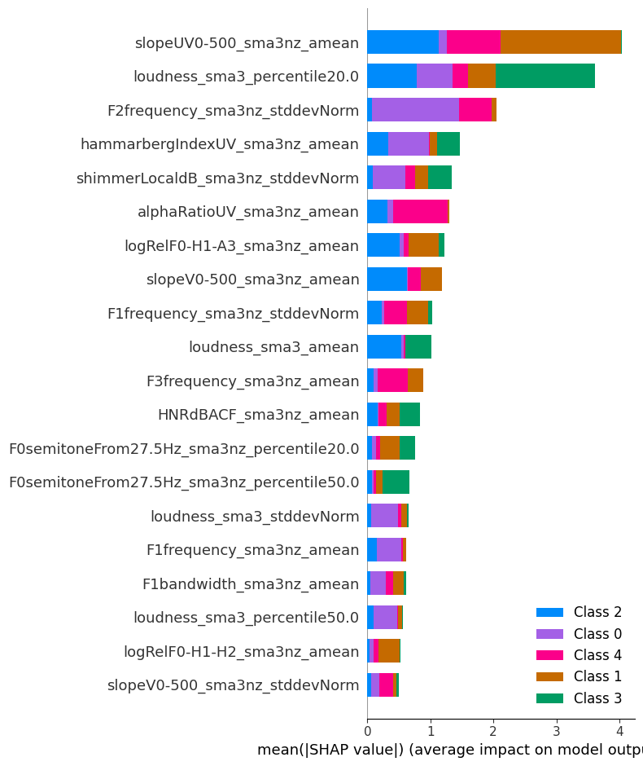
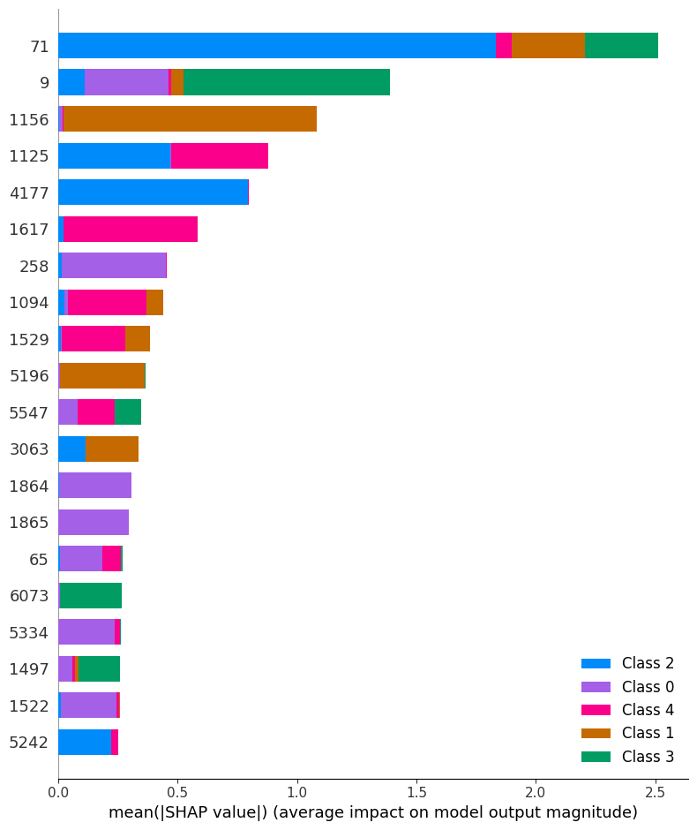
Experiments
output
audio
Feature set
Random
forest
 | Training ACC | Clean Testset ACC | Noisy Testset ACC
eGeMAPS | 100% | 92.61% | 48.99%
eGeMAPS+Feature Extraction | 100% | 95.07% | 50.14%
ComParE 2016 | 100% | 96.19% | 65.41%
ComParE 2016+Feature Extraction | 100% | 91.49% | 61.09%
eGeMAPS+Feature Extraction + ComParE 2016+Feature Extraction | 100% | 96.89% | 38.24%
eGeMAPS
ComParE 2016
Notes:
I did multiple experiments here
So the opensmile baseline given by ta used eGeMAPS eGeMAPS set yielded a clean test set accuracy of 92.61% and a significant drop to 48.99% in noisy conditions.The SHAP values of this set as you can see on the graph, illuminate the impact of each feature on the model's output. This allowed us to focus on features with the highest mean impact on model output magnitude,
Enhancing eGeMAPS with additional feature extraction improves the noise scenario slightly, indicating the need for more comprehensive feature sets in challenging acoustic environments.
Then i changed the dataset to ComParE 2016 The ComParE 2016 feature set performs well in clean conditions and shows a remarkable resilience to noise with an accuracy of 65%,
Surprisingly, when we applied additional feature extraction to the ComParE 2016 set, we observed a decrease in clean test set accuracy from 96.19% to 91.49%The introduction of new features might have led to overfitting,It's also possible that the new features introduced noise or redundancies that confused the model rather than providing it with useful new information.

Slide 10
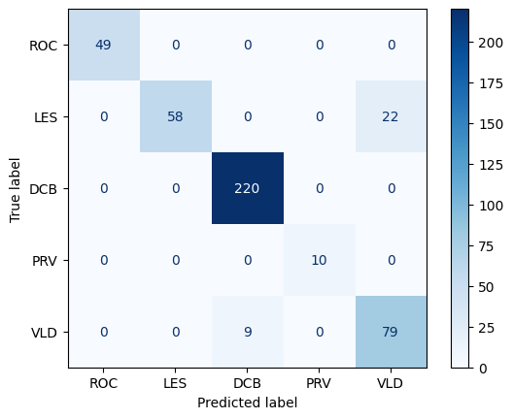
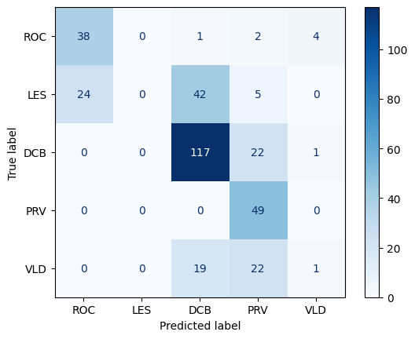
OpenSMILE & RandomForest
ComParE 2016
Training Accuracy | Clean Testset Accuracy | Noisy Testset Accuracy
100.0% | 96.20% | 65.41%
Future work:By editing the configuration files, users can select individual low-level descriptors (LLDs), apply custom statistical functionals, and create novel feature sets. This flexibility supports innovative approaches to audio analysis, ensuring the extracted features are optimally aligned with the research objectives.
Notes:
The confusion matrices give us a clear picture of where our model stands. We achieve perfect training accuracy, excellent performance on clean data, but we notice that the noise still poses a significant challenge.
I did some more research For future work, we aim to the ability to tweak the configuration files, select specific low-level descriptors, and create their our novel feature sets.
This level of customization may allow us to align the feature extraction process more closely with their specific research objectives and potentially improve the robustness and accuracy of their models.

Slide 11
Put Things Together
Pipeline | Training Acc | Clean Testset Acc | Noisy Testset Acc
Baseline | 100% | 76.90% | 61.90%
GTCC+MFCC with XGBoost | 100% | 81.43% | 75.22%
Mel-spectrogram + CNN | 99.73% | 94.63% | 68.88%
opensmile(ComParE 2016)+randomforest | 100% | 96.20% | 65.41%
Notes:
In conclusion, our experimentation with various audio processing models has led to significant strides beyond our initial baseline.
My model and Hanry's both introduced substantial improvements, offering a notable increase in both clean and noisy test set accuracies.
However, it's Yuki's modelutilizing GTCC+MFCC with XGBoost, made a significant leap forward, Yuki's approach outshined the rest.

